Slide 1
Programming and Connection of LCD
LCD displays like these are very popular and broadly used in many electronics projects because they are great for displaying simple information, like sensors data, while being very affordable.
An LCD character display is a unique type of display that can only output
individual ASCII characters with fixed size. Using these individual characters then we can form a text.
If we take a closer look at the display, we can notice that there are small rectangular areas composed of 5×8 pixels grid. Each pixel can light up individually, and so we can generate characters within each grid.

Slide 2
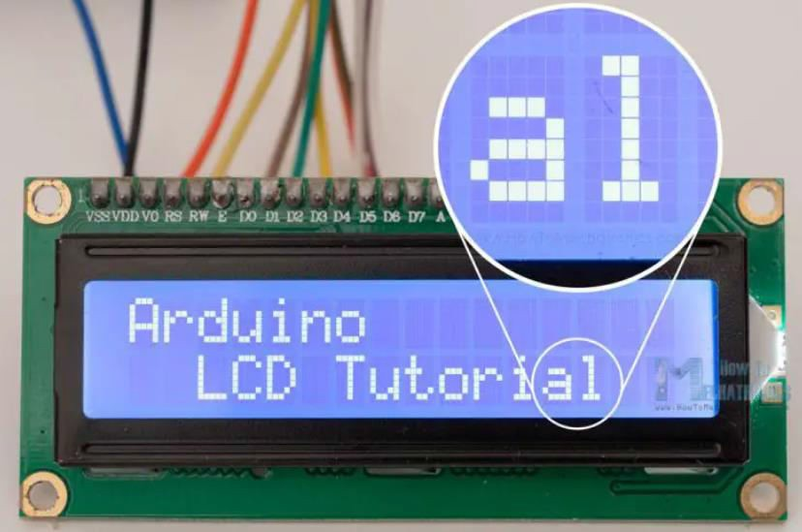

Slide 3
The number of the rectangular areas define the size of the LCD. The most popular LCD is the 16×2 LCD, which has two rows with 16 rectangular areas or characters. Of course, there are other sizes like 16×1, 16×4, 20×4 and so on, but they all work on the same principle. Also, these LCDs can have different background and text color.
16×2 LCD Pinout
It has 16 pins and the first one from left to right is the Ground pin. The second pin is the VCC which we connect the 5 volts pin on the Arduino Board. Next is the Vo pin on which we can attach a potentiometer for controlling the contrast of the display.
Next, The RS pin or register select pin is used for selecting whether we will send commands or
data to the LCD. For example, if the RS pin is set on low state or zero volts, then we are sending commands to the LCD like set the cursor to a specific location, clear the display, turn off the display and so on. And when RS pin is set on High state or 5 volts we are sending data or characters to the LCD.

Slide 4
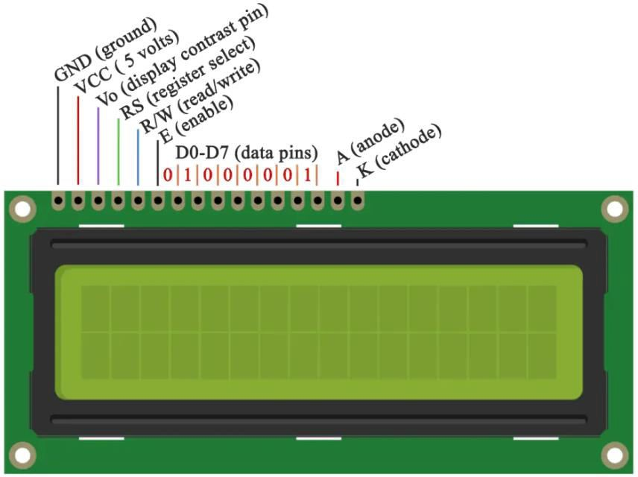

Slide 5
Next comes the R/W pin which selects the mode whether we will read or write to the LCD. Here the write mode is obvious and it is used for writing or sending commands and data to the LCD. The read mode is used by the LCD itself when executing the program.
Next is the E pin which enables the writing to the registers, or the next 8 data pins from D0 to D7. So through this pins, we are sending the 8 bits data when we are writing to the registers or for example, if we want to see the latter uppercase A on the display we will send 0100 0001 to the registers according to the ASCII table. The last two pins A and K, or anode and cathode are for the LED back light.
From the Arduino’s official website, you can find and see the functions of the library which enable easy use of the LCD. We can use the Library in 4 or 8 bit mode. In this tutorial we will use it in 4-bit mode, or we will just use 4 of the 8 data pins.

Slide 6
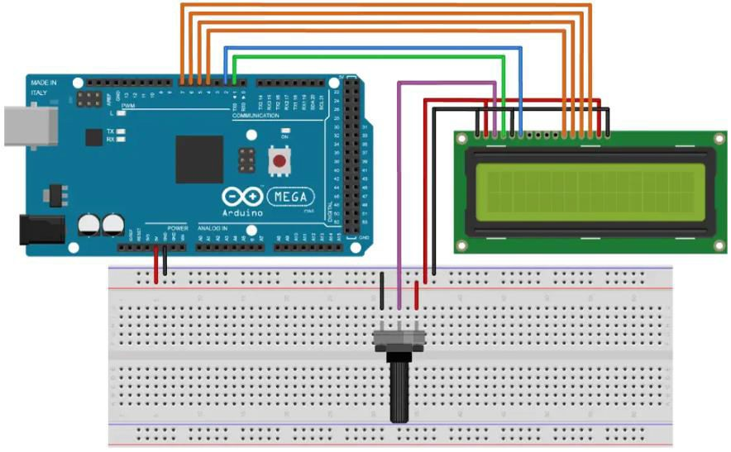
Wiring Diagram of Arduino to LCD
Here’s how we need to connect the 16×2 LCD display to an Arduino board.

Slide 7
We will use just 6 digital input pins from the Arduino Board. The LCD’s registers from D4 to D7 will be connected to Arduino’s digital pins from 4 to 7. The Enable pin will be connected to pin number 2 and the RS pin will be connected to pin number 1. The R/W pin will be connected to Ground and the Vo pin will be connected to the potentiometer middle pin.
Components Required
16×2 Character LCD
Potentiometer
Arduino Board
Breadboard
Jumper Wires

Slide 8
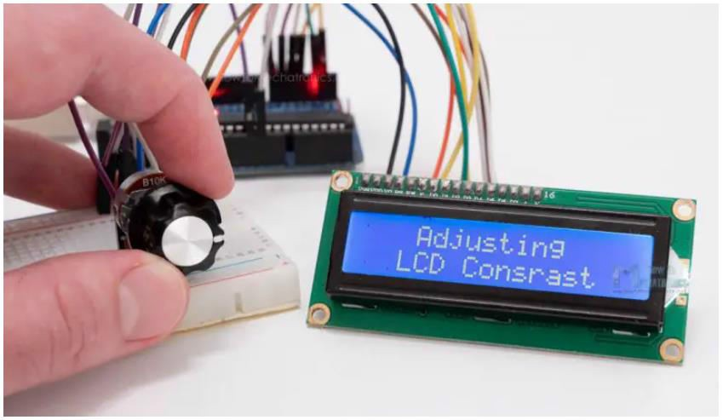
Adjusting the contrast of the LCD
We can adjust the contrast of the LCD by adjusting the voltage input at the Vo pin. We are using a potentiometer because in that way we can easily fine tune the contrast, by adjusting input voltage from 0 to 5V.

Slide 9
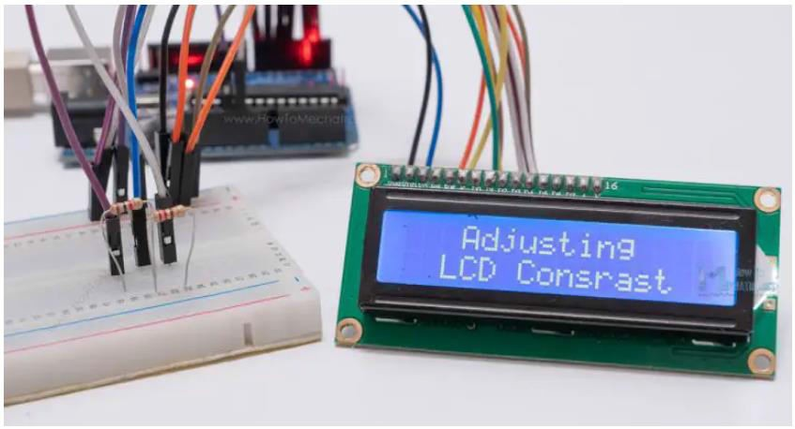
Can I use the LCD without Potentiometer?
Yes, in case we don’t have a potentiometer, we can still adjust the LCD contrast by using a voltage divider made out of two resistors. Using the voltage divider we need to set the voltage value between 0 and 5V in order to get a good contrast on the display. I found that voltage of around 1V worked worked great for my LCD. I used 1K and 220 ohm resistor to get a good contrast.

Slide 10
There’s also another way of adjusting the LCD contrast, and that’s by supplying a PWM signal from the Arduino to the Vo pin of the LCD. We can connect the Vo pin to any Arduino PWM capable pin, and in the setup section, we can use the following line of code: analogWrite(11,100); // Generate PWM signal at pin D11, value of 100 (out of 255)
It will generate PWM signal at pin D11, with value of 100 out of 255, which translated into voltage from 0 to 5V, it will be around 2V input at the Vo LCD pin.
LCD Arduino Code
Here’s a simple code through which we can explain the working principle of the Liquid Crystal library.
#include <LiquidCrystal.h> // includes the LiquidCrystal Library
LiquidCrystal lcd(1, 2, 4, 5, 6, 7); // Creates an LCD object. Parameters: (rs, enable, d4, d5, d6, d7)

Slide 11
void setup() {
lcd.begin(16,2); // Initializes the interface to the LCD screen, and specifies the dimensions (width and height) of the display
}
void loop() {
lcd.print("Arduino"); // Prints "Arduino" on the LCD
delay(3000); // 3 seconds delay
lcd.setCursor(2,1); // Sets the location at which subsequent text written to the LCD will be displayed
lcd.print("LCD Tutorial"); delay(3000);
lcd.clear(); // Clears the display
lcd.blink(); //Displays the blinking LCD cursor
delay(4000);

Slide 12
lcd.setCursor(7,1);
delay(3000);
lcd.noBlink(); // Turns off the blinking LCD cursor
lcd.cursor(); // Displays an underscore (line) at the position to which the next character will be written
delay(4000);
lcd.noCursor(); // Hides the LCD cursor
lcd.clear(); // Clears the LCD screen
}

Slide 13
Code Explanation
First thing we need to do is it insert the Liquid Crystal Library. We can do that like this: Sketch > Include Library > Liquid Crystal. Then we have to create an LC object. The parameters of this object should be the numbers of the Digital Input pins of the Arduino Board respectively to the LCD’s pins as follow: (RS, Enable, D4, D5, D6, D7). In the setup we have to initialize the interface to the LCD and specify the dimensions of the display using the begin() function.
In the loop we write our main program. Using the print() function we print on the LCD. lcd.print("Arduino"); // Prints "Arduino" on the LCD
The setCursor() function is used for setting the location at which subsequent text written to the LCD will be displayed.
lcd.setCursor(2,1); // Sets the location at which subsequent text written to the LCD will be displayed

Slide 14
The blink() function is used for displaying a blinking cursor and the noBlink() function for turning off.
lcd.blink(); //Displays the blinking LCD cursor
The cursor() function is used for displaying underscore cursor and the noCursor() function for turning off. Using the clear() function we can clear the LCD screen.
lcd.clear(); // Clears the LCD screen

Slide 15
Scrolling text example on 16×2 LCD and Arduino
In case we have a text with length greater than 16 characters, we can scroll the text using the scrollDisplayLeft() or scrollDisplayRight() function from the LiquidCrystal library.
Here’s an example code:
#include <LiquidCrystal.h>
LiquidCrystal lcd(1, 2, 4, 5, 6, 7); // Creates an LCD object. Parameters: (rs, enable, d4, d5, d6, d7)
void setup() { lcd.begin(16, 2);
lcd.print("Scrolling Text Example");
}

Slide 16
void loop() { lcd.scrollDisplayLeft();
delay(500);
}
We can choose whether the text will scroll left or right, using the scrollDisplayLeft() or scrollDisplayRight() functions. With the delay() function we can set the scrolling speed.
If you want more control over how the text is scrolling, you could also make the scrolling on your own using a “for” loop.
Here’s an example:
#include <LiquidCrystal.h>
LiquidCrystal lcd(1, 2, 4, 5, 6, 7); // Creates an LCD object. Parameters: (rs, enable, d4, d5, d6, d7)

Slide 17
void setup() {
lcd.begin(16, 2); // Initializes the interface to the LCD screen, and specifies the dimensions (width and height) of the display
}
void loop() {
// scroll text to the right
for (int i = 0; i <= 13; i++) {
lcd.setCursor(i, 0); // Sets the location at which subsequent text written to the LCD will be displayed
lcd.print("LCD"); delay(500); // 1second delay
lcd.clear(); // Write a character to the LCD
}

Slide 18
// scroll text to the left
for (int i = 12; i >= 1; i--) { lcd.setCursor(i, 0);
lcd.print("LCD");
delay(500);
lcd.clear();
}
}
Conclusion
So, we have covered pretty much everything we need to know about using an LCD with Arduino. These LCD Character displays are really handy for displaying information for many electronics project.

